Slide 1
Eclipse Plug-in Development
Eclipse RCP Development Part 1
Based on Eclipse 3.x

Slide 2
Contents
Overview
Application
org.eclipse.core.runtime.applications
IApplication
Advisor Classes
WorkbenchAdvisor
WorkbenchWindowAdvisor
ActionBarAdvisor
Extensions
Launch

Slide 3
Overview
Eclipse RCP
Rich Client Platform
Based on a dynamic plug-in model
Same toolkits and extension points with Eclipse
Minimum requires:
org.eclipse.ui
org.eclipse.core.runtime

Slide 4
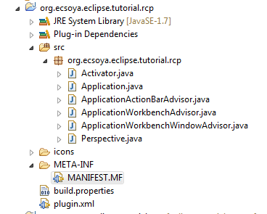
Overview
Eclipse RCP

Slide 5
Application
org.eclipse.core.runtime.applications
<extension
id="application"
point="org.eclipse.core.runtime.applications">
<application>
<run
class="org.ecsoya.eclipse.tutorial.rcp.Application">
</run>
</application>
</extension>

Slide 6
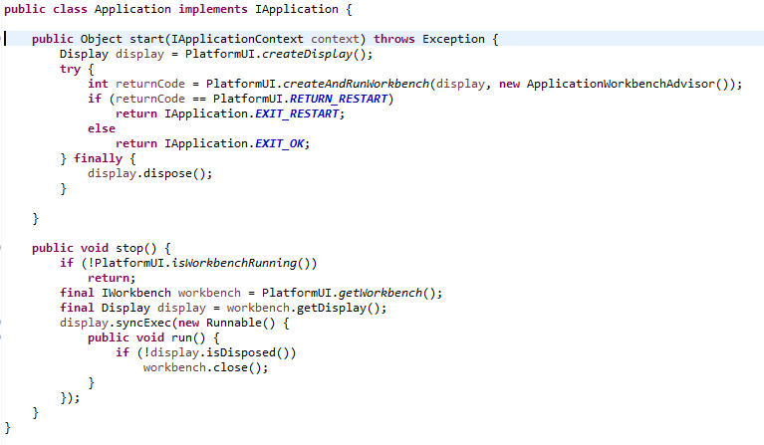
Application
IApplication
start
WorkbenchAdvisor
stop

Slide 7
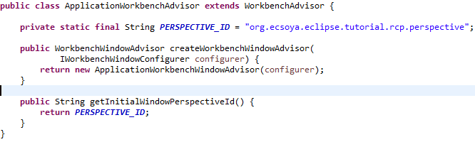
Advisor Classes
WorkbenchAdvisor
Perspective
WorkbenchWindowAdvisor

Slide 8
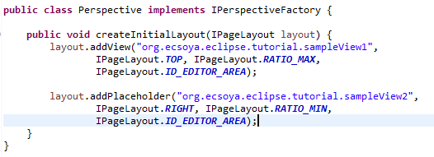
Advisor Classes
Perspective
org.eclipse.ui.perspectives
IPerspectiveFactory

Slide 9
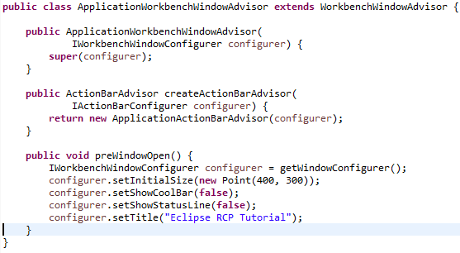
Advisor Classes
WorkbenchWindowAdvisor
ActionBarAdvisor
Configuration
preWindowOpen
postWindowCreate
postWindowOpen
postWindowClose
IWorkbenchWindowConfigurer

Slide 10
Advisor Classes
IWorkbenchWindowConfigurer
IWorkbenchWindowConfigurer configurer = getWindowConfigurer();
configurer.setInitialSize(new Point(400, 300));
configurer.setTitle("Eclipse RCP Tutorial");
configurer.setShellStyle(SWT.SHELL_TRIM);
configurer.setShowMenuBar(true);
configurer.setShowCoolBar(false);
configurer.setShowPerspectiveBar(true);
configurer.setShowStatusLine(false);
configurer.setShowFastViewBars(true);
configurer.setShowProgressIndicator(true);

Slide 11
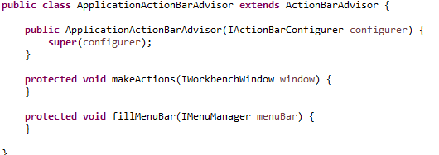
Advisor Classes
ActionBarAdvisor
Create global actions
ActionFactory.*.create(window)
IAction
Contribute actions to
Menubar
Toolbar

Slide 12
Extensions
Eclipse template projects
RCP application with a view
RCP application with an intro
RCP Mail Template

Slide 13
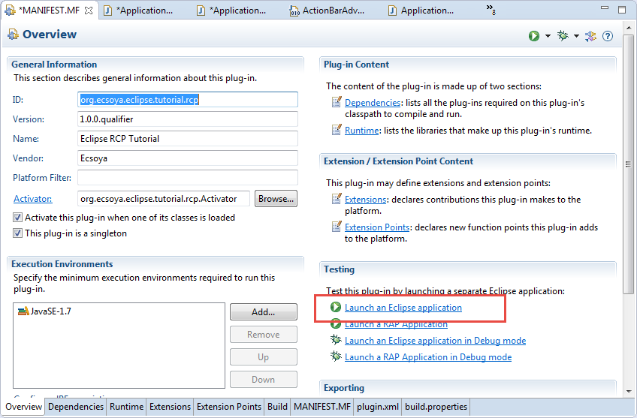
Launch

Slide 14
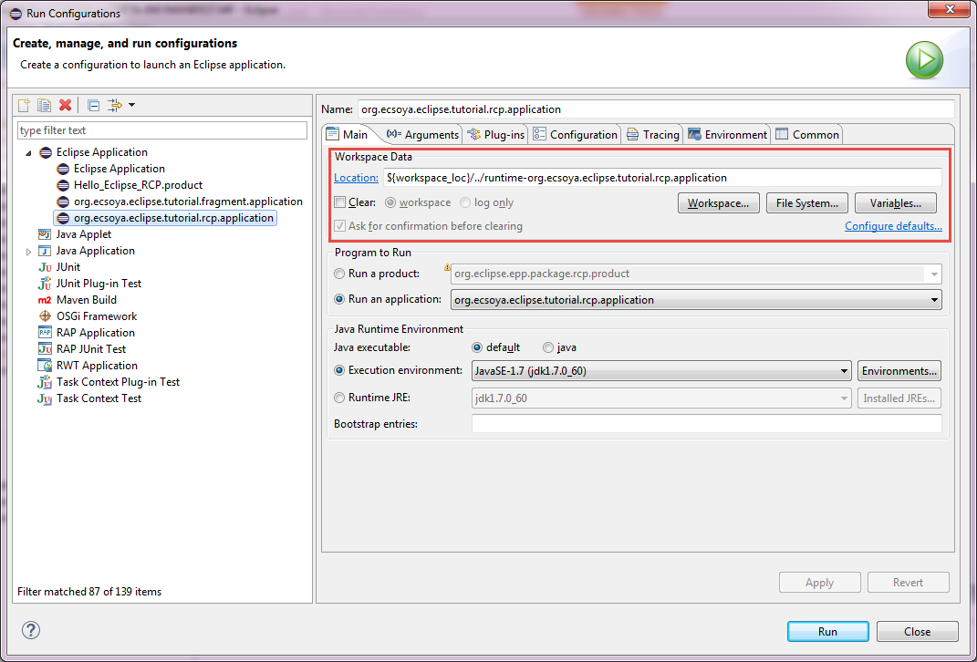
Launch
Run/Debug -> Run/Debug Configurations

Slide 15
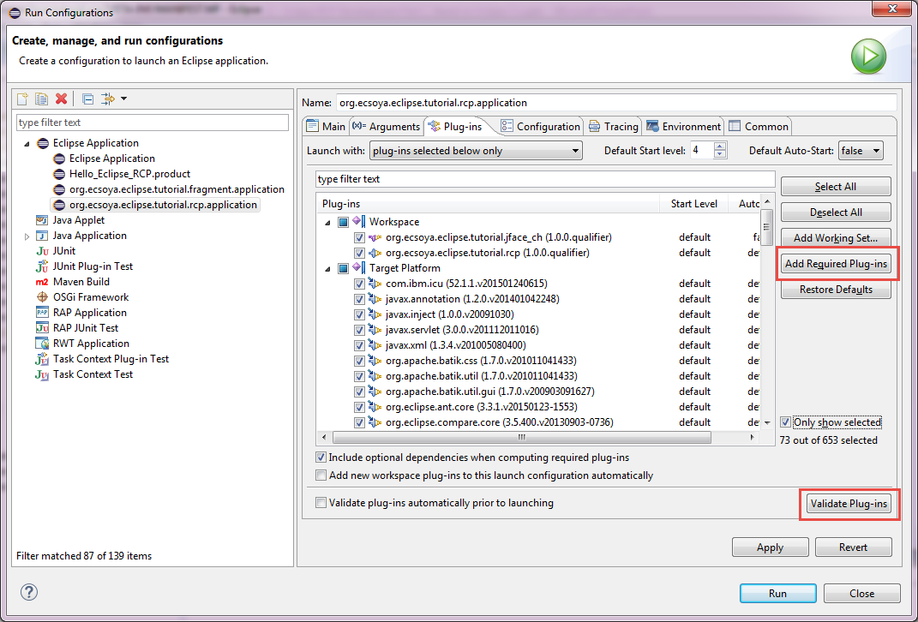
Launch
Run/Debug -> Run/Debug Configurations

Slide 16
Any Questions?
Skype: jin.liu.soyatec
Email: jin.liu@soyatec.com

Slide 17
The end

